Slide 1
Globalisation Localisation

Slide 2
What’s that?
Globalisation
process of making sure that your app works well in multiple cultures
making your app act appropriately for different markets without any changes or customizations
Localisation
refers making our app to adapt new market
remove all the hard coded strings and images and instead mark such elements with a unique identifier

Slide 3
Localisation
De-stringing your app
Remove all hard coded strings from the xaml and c# code
Store all in a resource file
.resw extension
Placed in a special directory called Strings
Contains a subfolder for every supported language
Sub folder naming convention
En-GB – English in GB
En-US – the other English ☺

Slide 4
Localisation
Pattern is called BCP-47 language tag
Can also use the language to force the runtime to use localised resources for every region
Using a folder named “en” means English used for all regions that use English (US, GB, Australia etc)
In the subfolder, create a resources file called Resources.resw
Rename any old .resx files for the new convention after copying

Slide 5
Localisation
Create a UWP
Add a textblock to the xaml page
Give it a x:name=“tblTestString”
Used for the code-behind
Give it a x:Uid=“uidTestString”
Independent of the of the name and specifically for the localisation process

Slide 6
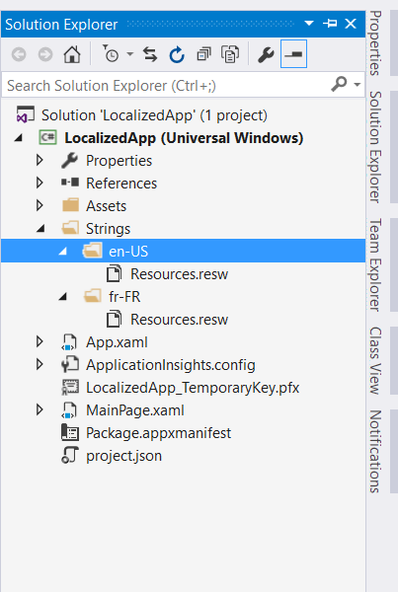
Localisation
Create a folder called Strings
Create a sub folder called en-US, fr-FR
Create a Resources.resw file in each folder

Slide 7
Localisation
In the resource file, reference all of the properties to be changed
String, color, height, width or any property and then set the value to be used if the app is run with that specific culture
Edit the en-US file
Add uidTestString.Text as Hello
Add uidTestString.Background as red
Similar in the French file
Add uidTestString.Text as Bonjour
Add uidTestString.Background as blue

Slide 8
Change your language
Control Panel -> Clock, Language and Region ->Language
Add a Language (select France)
To make the selected language the default, move it to the top of the list
Then re run the app and check that the other resource file is used

Slide 9
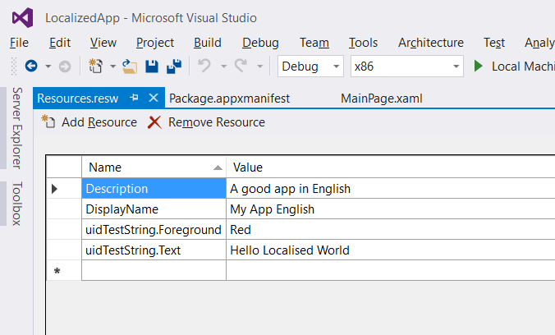
Localising the App Manifest
Distributing to multiple markets….
Localise the manifest
Allows a translated description in the Windows Store
Display name, Short Name, Description
Localise the App Name and Description
Add two categories DisplayName, Description to the resource file

Slide 10
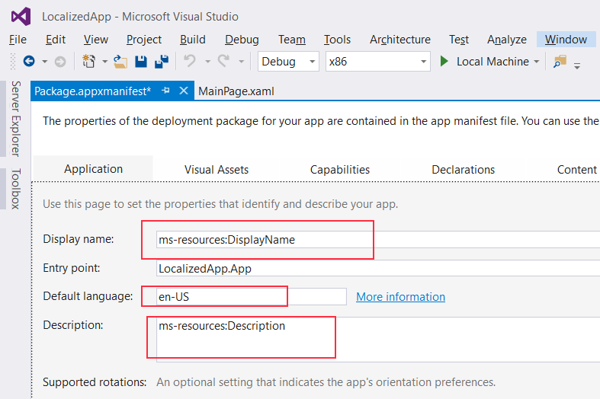
Set the values
Inside manifest, use ms-resource:<identifier> to reference resource strings
To set your application title, you can add a DisplayName to your resource file and reference it with ms-resource: DisplayName
for Description reference it with ms-resource: Description

Slide 11
Localising Images
Don’t have to unless they contain text or other culture specific information
Localised images add to the size of the download
Avoid if possible
If you can’t avoid, you have two choices
Create resource specific colders (“Images/en-US”)
Name the files with culture specific suffix
Flag.lang-en-US.png
Flag.lan-fr-FR.png

Slide 12
Localising Images
Similar to the different resolutions and scales used for images in the assets folder
Depending on the resolution of the device, the system uses different images that you have included in the build

Slide 13
Multilingual App Toolkit
Extension to visual Studio
Can localise yourself, use the Machine Translation Service, or with the help of localisers
Need to download and install the toolkit from the Windows Dev Center
Once installed, enable from the tools menu
Adds an .xlf file to a new subfolder for a test-only language called Pseudo Language
In MultilingualResources Folder
Once added…

Slide 14
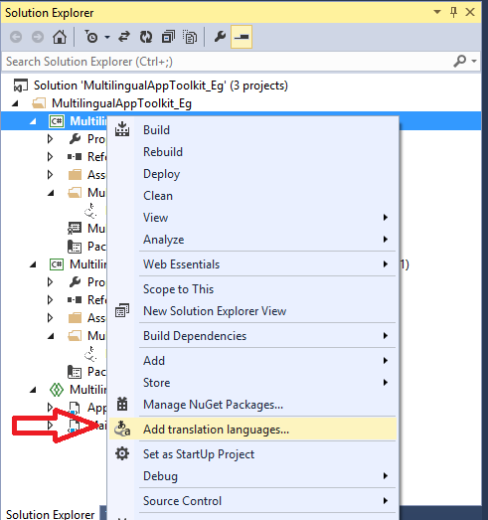
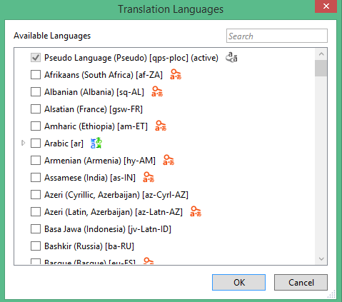

Slide 15
Multilingual App Toolkit
Pseudo Language and default language are selected
After adding another, rebuild the app,
This populates the .xlf files with a translation for each item from the default language .resw file
Initially, this is just a copy
Can generate machine translation based on the Microsoft Translator service
Right click on each file and “Generate machine translations”
All translations will be in “need review” state
Allows you to review for differences between properties like color and values like strings

Slide 16
Pseudo Language
Strings are longer than corresponding English strings
Catch cases of truncation, wrapping
Add it in the control panel -> Clock, language, region
Have to search for qps-loc as it is not listed

